Slide 1
Intrusion Alerting system
Under guidance of
Mrs. dhivya P,
Assistant professor department of CSE,
BIT,
Sathy.
Arun prakash N & 192IT116
Bharath A & 192IT124
Arya NM & 192IT117

Slide 2
Abstract
Nowadays a lot of people are fixing CCTV cameras in their home,office,public places and even in schools and colleges. Especially in a home both husband and wife will go to work and they will come to the home in the evening. They need to check their CCTV cameras frequently to check if any unknown person is standing in front of the home or anything else is happenning. Instead of monitoring the CCTV footage , this alert system will ensure the strangers in front of our home.This system will be very useful to the people who will go for a job. Before seen is one of the situations now we are going to see another situation considering they have a child. They left their child and went to work. At that time they needed to check their CCTV cameras frequently if any unknown person was standing or roaming inside the home. Checking cameras frequently is a waste of time. Considering the situation,some of the people who work in other countries and other states whose house is located in their hometown need to check their CCTV footage frequently.Consider the situation elderly people are living in the home and their son or daughter or daughter-in-law working candidates. Elderly people did not know about CCTV footage and they did not know if an unknown person came inside the house at that time. Our product will help.Consider the situation ,shop owners closing the shop and going to their home. He fixes the CCTV footage in his shop. He needs to check CCTV footage frequently to check if someone is standing inside the shop or anything is happening.Our project is to help the people who fall into the above problem statement. Our project will take the live feed of the CCTV camera and it will detect a person if a person is identified in front of the CCTV camera it will generate a message and send it to the respective mobile phone,for example “a person is standing in front of the camera please do check your CCTV footage”.

Slide 3
Problem Statement Addressed
Nowadays a lot of people are fixing CCTV cameras in their home,office,public places and even in schools and colleges. Especially in a home both husband and wife will go to work and they will come to the home in the evening. They need to check their CCTV cameras frequently to check if any unknown person is standing in front of the home or anything else is happening. Instead of monitoring the CCTV footage , this alert system will ensure the strangers in front of our home.This system will be very useful to the people who will go for a job.

Slide 4
Existing Solution to the Problem Addressed
already object detection on live cctv footage is there, it detect all the objects covered in the footage and sent whatsapp messages to the respective owners .
our invention is instead of detecting all the objects we detect only an person object present in the footage and instead of sending whatsapp messages we sent an normal phone message because sometimes the owners may not have internet connection on that time messages will not receive properly so we sent an normal phone messages(SMS).

Slide 5
Proposed Solution to the Problem Addressed
OpenCv is an open source library for computer vision,machine learning and image processing. Language are used to develop the project using python.
It takes live feed of the CCTV footage using Opencv-Videocapture method via rtsp link.
Confighpath: ssd_mobilenet_v3 ,weightspath : frozen_inference_graph,classnames : coco names used to detect the object.
DNN is a Detection model using the above mentioned configpath and weightspath.
cv2.rectangle() is used to project the frame in a rectangle box.
FONT_HERSHEY_COMPLEX() is used for naming the object.
Twilio API is used for sending normal messages to their phone numbers.

Slide 6
CAPTURING LIVE CCTV FOOTAGE:
In your project we have used opencv video capture method() to capture the live CCTV footage which is used to work with cameras where we can read video,display video and save video. It is a straightforward interface to capture live streams with the camera. we need to create a video capture object to capture a video. Use that object for further actions.

Slide 7
IMPORTING NECESSARY FILE:
In your project we have used coco dataset for labelling and segmentation,ssd_mobilenet_V3 and frozen inference graph for detecting an object.

Slide 8
COCO DATASET:
For deep learning or machine learning models to get precision a large dataset is necessary. COCO stands for common objects in context.This dataset contains objects from an everyday context. It is easier to identify a bottle in front of a blank wall than when it is in a classroom where children are playing hopscotch in the background. The COCO dataset provides the labelling and segmentation of the objects in the images. There are 80 object categories of labelled and segmented images in the file. Thus our model can detect and identify 80 types of objects.

Slide 9
SSD MOBILENET V3:
The mobilenet-ssd model is a Single-Shot multibox Detection (SSD) network, intended to perform object detection. In simple words this file is a pre-trained Tensorflow model and has already been trained on the COCO dataset.

Slide 10
FROZEN GRAPH:
Freezing is the process to identify and save all of the required things(graph, weights etc) in a single file that you can easily use. Frozen graphs are commonly used for inference in TensorFlow and are stepping stones for inference for other frameworks.

Slide 11
DETECTION MODEL:
For detecting an object we have a dnn detection model using configpath and weightpath(ssd mobilenet V3,frozen inference graph). The detection model allows settings params for preprocessing input images. Detection model creates net from file with trained weight and config,sets preprocessing inputs,runs forward pass and returns result detections. dnn detection model creates a dnn detection model object. use that object for further actions.It is a deep neural network model that helps in loading a pretrained model, (ssd-mobilenet in our case). The DNN module allows loading pre-trained models of most popular deep learning frameworks, including Tensorflow, Caffe, Darknet, Torch.

Slide 12
CAPTURING THE FOOTAGE FRAME BY FRAME:
The next step is to capture the CCTV footage frame by frame. We have already created a video capture object for the camera. Use that object in an infinite while to read the frames using read() method.

Slide 13
DETECTING AN OBJECT:
Next step to detect an object. We have already created the dnn detection model object using that object in the infinite while loop which is already created while capturing the footage frame by frame. Using the detect() member function in the dnn detection model object. In that function we need to give the input frame,create the input blop,run net and return result detections. As a result we get classids(class indexes),confidences(set of corresponding confidences),boxes(set of bounding boxes).

Slide 14
DRAWING BOXES ON THE OBJECT:
The next step is to draw a rectangular box and put the text on the detected object. We have used the rectangle() method to draw a rectangular box on the detected object and the puttext() method to put the text string on the detected object(image) . Font style used in the puttext method is FONT HERSHEY COMPLEX .

Slide 15
CHECKING FOR A PERSON:
We have already detected an object using the detect() member function which returns classids(class indexes),confidences(set of corresponding confidences),boxes(set of bounding boxes) . using an for loop inside the infinite loop which is already created in capturing the footage frame by frame step. store the classids,confidences, boxes in another variable. use that variable to check the condition whether it is a person or not. if it is a person we need to send the normal phone message to the respective owners instantly.

Slide 16
SENDING NORMAL PHONE MESSAGES:
To send the normal phone messages to the respective owners we have used TWILIO API. It is a web application programming inference(API) that software developers can use to add communication such as phone calling,messaging and two factor authentication into their python applications.

Slide 17
DISPLAY THE DETECTED OBJECT:
To display the detected object captured on the live CCTV footage using imshow() method available in the opencv open source computer vision. It displays the footage in the separated window.

Slide 18
Project Work Plan
to implement this project we need an system or raspberry pi with python installed.
download the required data like coco dataset etc.
connect the cctv camera with the system via network cabel.
import the necessary python package.
insert the python code and run it.
the necessary output will receive.

Slide 19
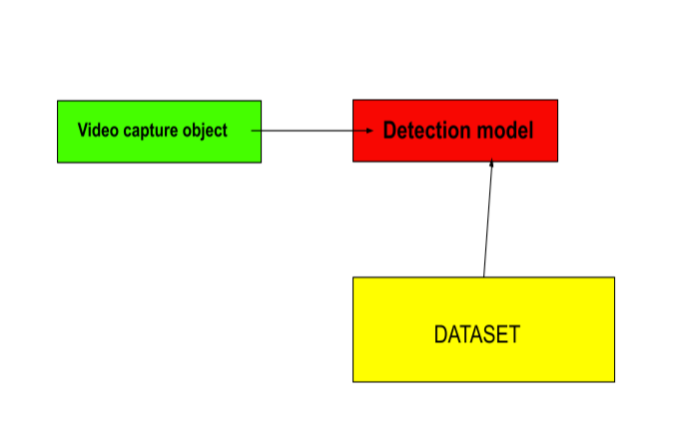
Block Diagram and/or Circuit Diagram

Slide 20
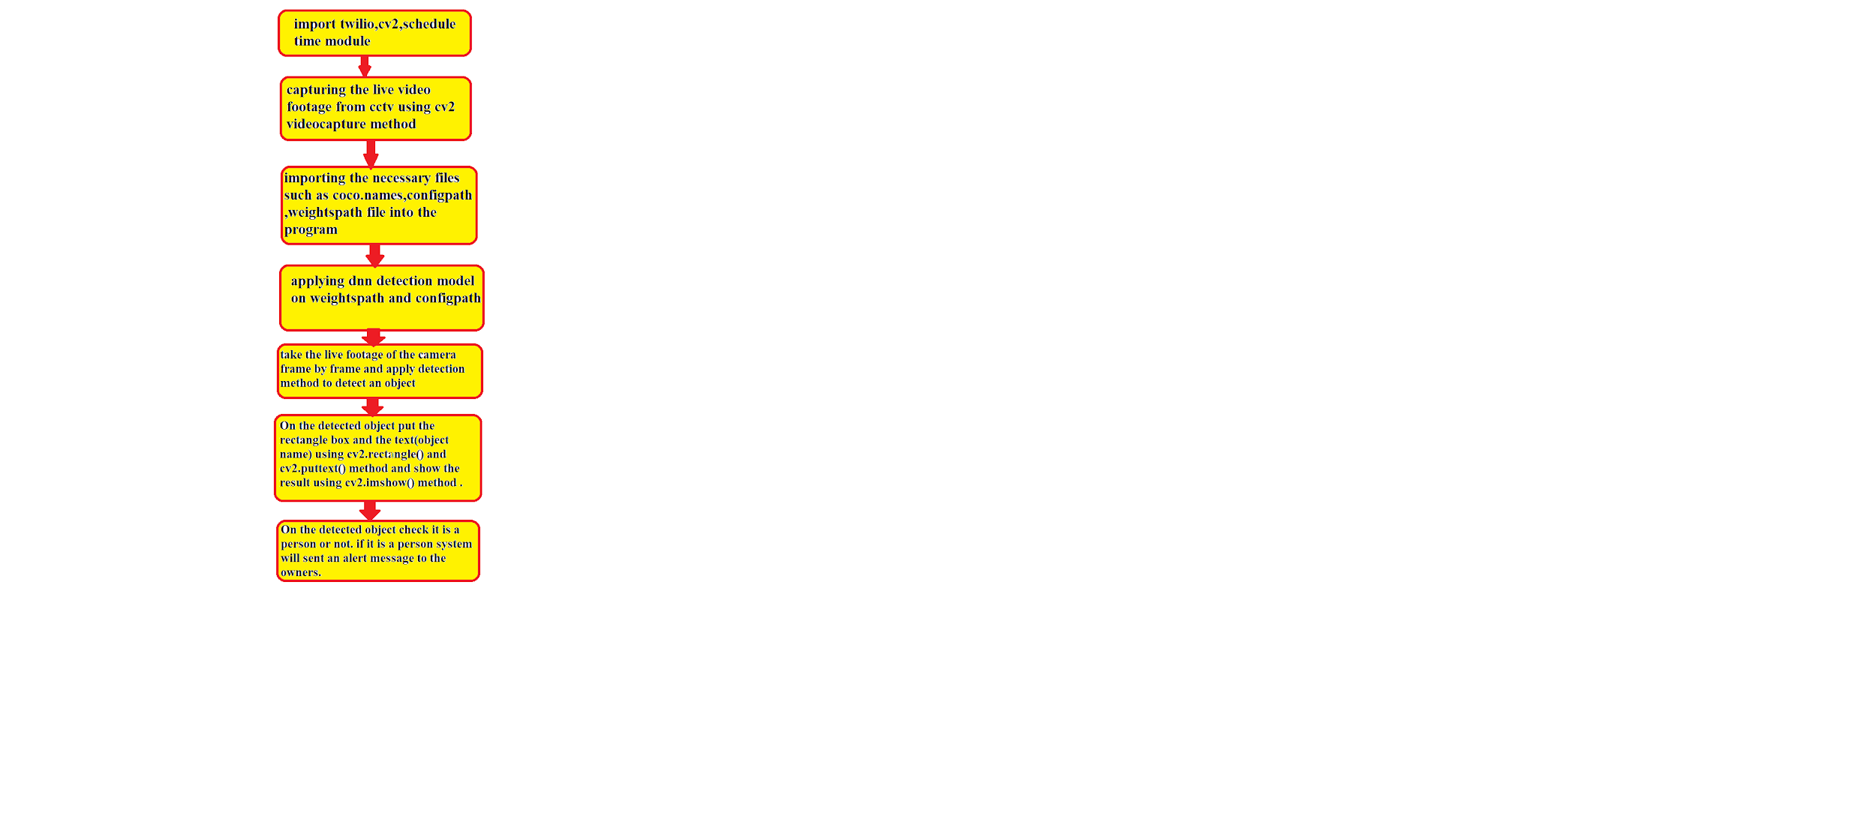
Flow Chart

Slide 21
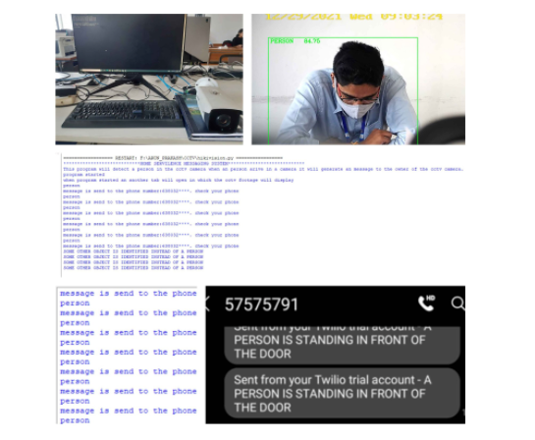
Effective utilization of the Modern Tool & Cloud

Slide 22
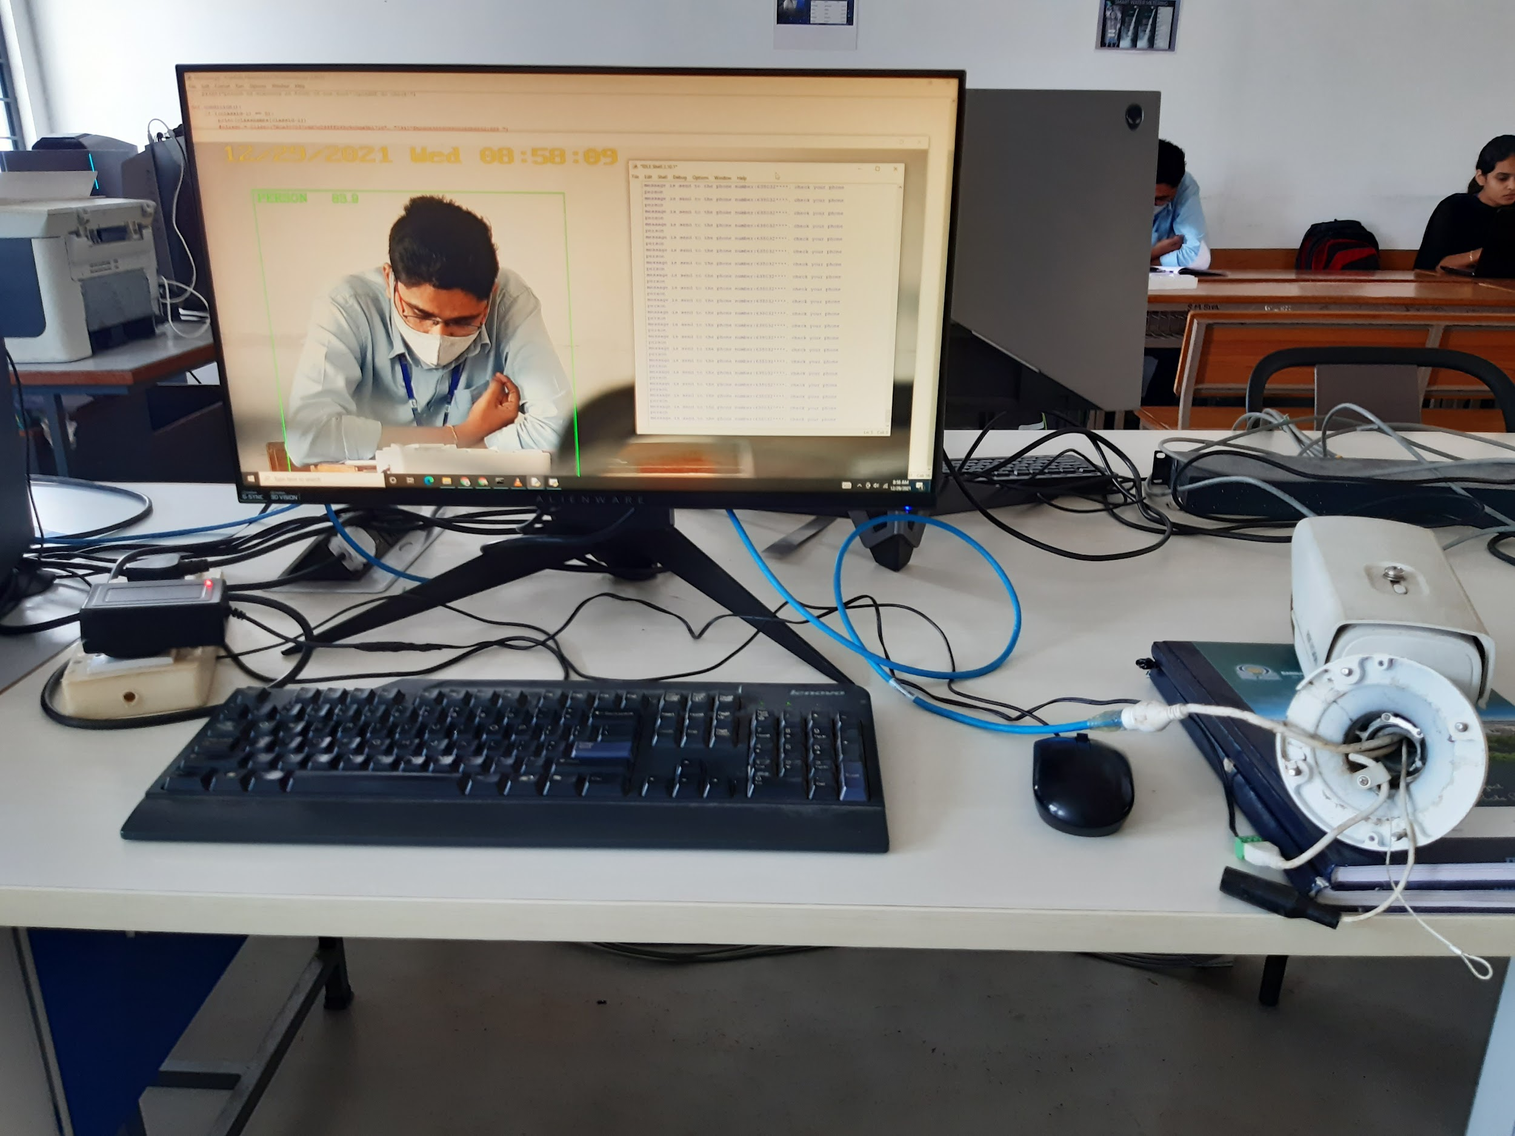
Prototype & Sample Output

Slide 23
Analysis of Results & Discussions
To detect an object we have used computer vision and deep learning techniques. This product will help people who are working in IT companies,college professors,and school teachers.This product will help the people who work in other countries and other states whose house is located in their hometown they need to check their CCTV footage. In that case our product will help.Consider the situation elderly people are living in the home and their son or daughter or daughter-in-law working candidates. Elderly people did not know about CCTV footage. Hence our product will help them.Consider the situation of a shop owner closing the shop and going to their home. He fixes the CCTV footage in his shop. He needs to check CCTV footage. In that situation our product will help.Our product is cost efficient.

Slide 24
Cost Benefit Analysis (List of Components / Service Used)
S.No | Component Name | Specification (IC number or Range or Value) | Unit Cost | Total Cost
1 | HIKIVISION IR NETWORK CAMERA |  | 8,000 | 8,000
2 | CAT6LSZH ETHERNET CABEL |  | 500 | 500
3 | CCTV CAMERA CONNECTOR |  | 50 | 50
4 | POWER ADAPTER |  | 500 | 500
 | ETHERNET CABEL TO CCTV CAMERA CONNECTOR |  | 500 | 500
5 | TWILIO API SUBSCRIPTION |  | 1000 | 1000
6 | RASPBERRY PI |  | 5000 | 5000
7 | RASPBERRY PI WIFI MODULE |  | 2000 | 2000

Slide 25
References
Ariponnammal, S. and Natarajan, S. (1994) “Transport Phonomena of SmSel – Xasx”, Pramana – Journal of Physics Vol.42, No.1, pp.421-425.
Barnard, R.W. and Kellogg, C. (1980), “Applications of Convolution Operators to Problems in Univalent Function Theory”, Michigan Mach, J., Vol.27, pp.81-94.
Shin, K.G. and Mckay, N.D. (1984), “Open Loop Minimum Time Control of Mechanical Manipulations and its Applications‟, Proc. Amer. Contr. Conf., San Diego, CA, pp. 1231-1236.
(sample references, the same format should be followed throughout)

